Slide 1
Mechanics（力学）:
The science of motion and its causes.
Mechanics is customarily divided into two parts:
Kinematics（运动学） → description of motion. (Chapter2 & 3, P16 – P76)
Dynamics（动力学）→ causes of motion. (Chapter4 – 11, P77 – P296)

Slide 2
Chapter 2 & 3
Motion in One, Two and Three Dimensions
Position and Displacement
Velocity
Acceleration
2D and 3D Motion
Relative Motion

Slide 3
2-1 Description of Motion
The world, and everything in it, moves. Even
seemingly stationary things, such as a house moves with the Earth, the Earth’s orbit around the Sun, the Sun’s orbit around the center of the Milky Way galaxy, and that galaxy’s migration relative to other galaxies.
绝对静止的物体是没有的——
运动的绝对性

Slide 4

To describe the position of an object, the other object which is referred to (Reference Frame 参考系）should be chosen. It is arbitrary.
物体的运动对不同参考系描述不同—运动的相对性
To determine the location of a body at the reference object quantitatively, a coordinate system is built on it.
y
O
x
z

Slide 5
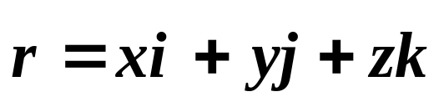
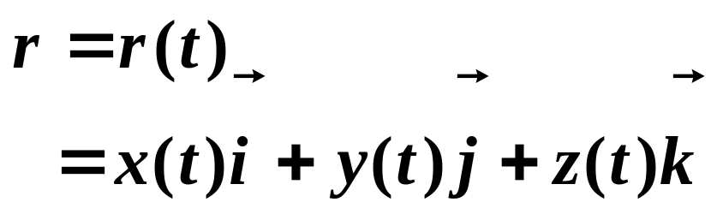

2-2. Position and Displacement
1. Position vector(位矢）−−The location of a particle relative to the origin of a coordinate system.
For a Cartesian system:
y
P (x,y,z,t )
Motion function ( 运动方程 )：
(t₀)
j
y
(t′ )
i
k
O
x
z
Trajectory equation ⎯⎯ 轨道方程:
x
z
f (x, y, z) = 0

Slide 6
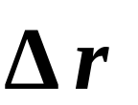
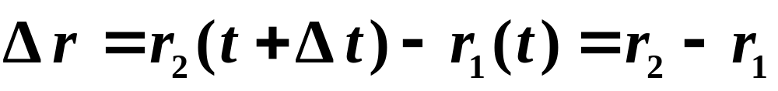
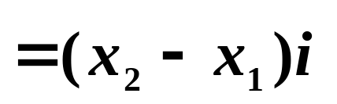
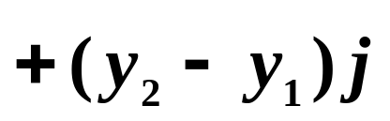
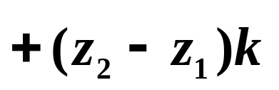
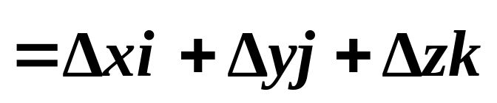
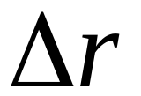
2. Displacement (位移矢量) —— A particle is changing in its position(描述质点空间位置变化的矢量):
y
B
A
The displacement vector extends from the head of the initial position vector to the head of the later position vector.
r₁(t)
Δr
r₂(t+ Δt )
0
x
z

Slide 7
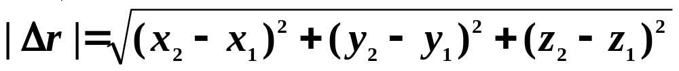
Notes about displacement：
(i) Vector —— The magnitude of vector should be the length of this vector, i.e.
(ii) Different from the path (路程)
Displacement depends only on the position of head to tail, independent with the real path (与具体路径无关)，状态量；
Path is the total lengths of the path curve，scalar，过程量。

Slide 8
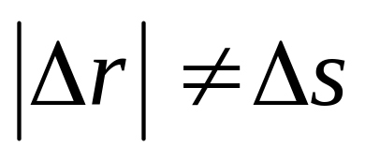

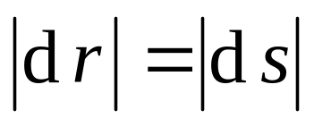
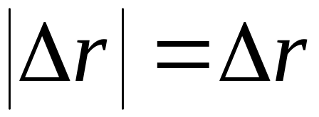
z
Hey!
P₁
Δs
P₂
In the limit as Δt →0,
r(t)
r(t+Δt )
Δr
O
y
x
?
r(t)
Δr
r(t+Δt )
O
(iii) The displacement is independent on the choice of origin.

Slide 9
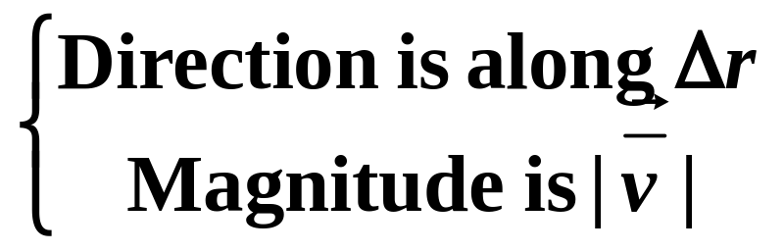
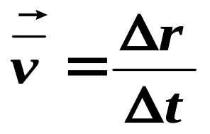
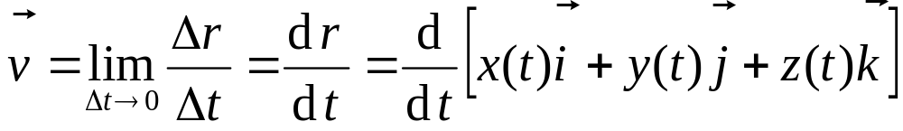
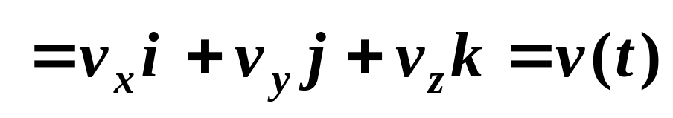
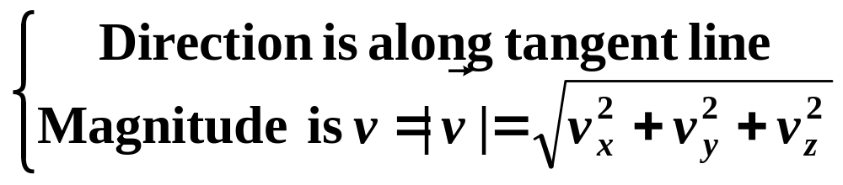
2-3. Average Velocity and Instantaneous Velocity
1. Average velocity
2. Instantaneous velocity (瞬时速度)

Slide 10
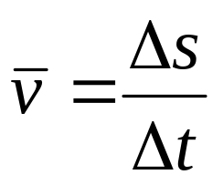
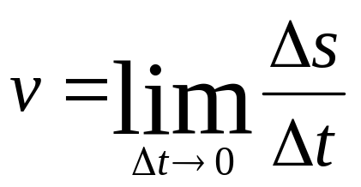
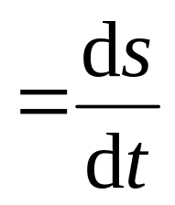
3. Average and Instantaneous speed (速率)
Average speed:
Instantaneous speed:
4. The relation between the Instantaneous velocity and instantaneous speed
The magnitude of instantaneous velocity equals to instantaneous speed (瞬时速度的大小等于瞬时速率).

Slide 11
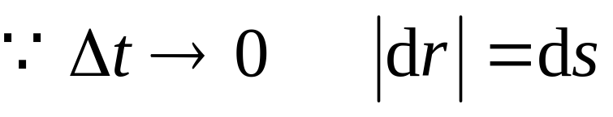
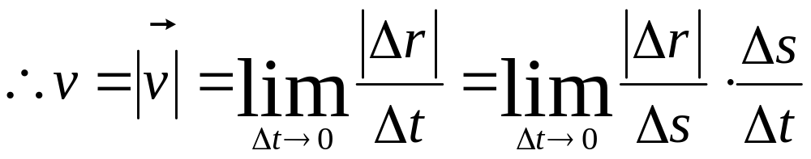
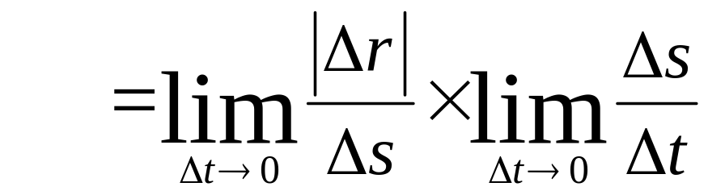
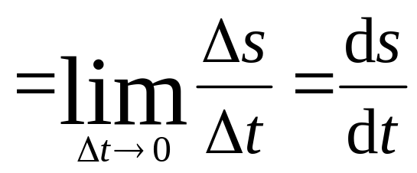
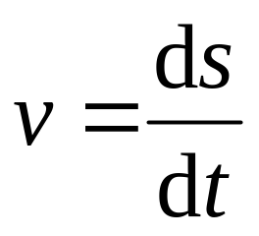
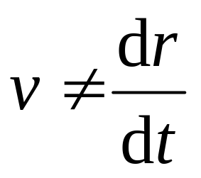
Proof:
Note:
Speed:
and
Speed is a scalar.

Slide 12
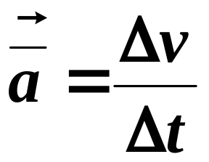
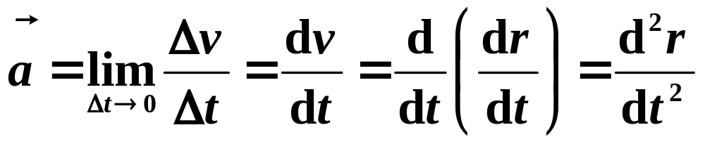
2-4. Average and Instantaneous Acceleration
Average acceleration:
v (t )
z
v (t )
P₁
Δv
·
P₂
·
v (t+Δt )
v (t+Δt )
r(t)
r(t+Δt )
Instantaneous acceleration:
O
y
x

Slide 13
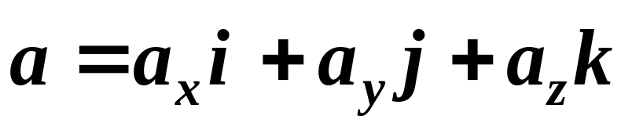
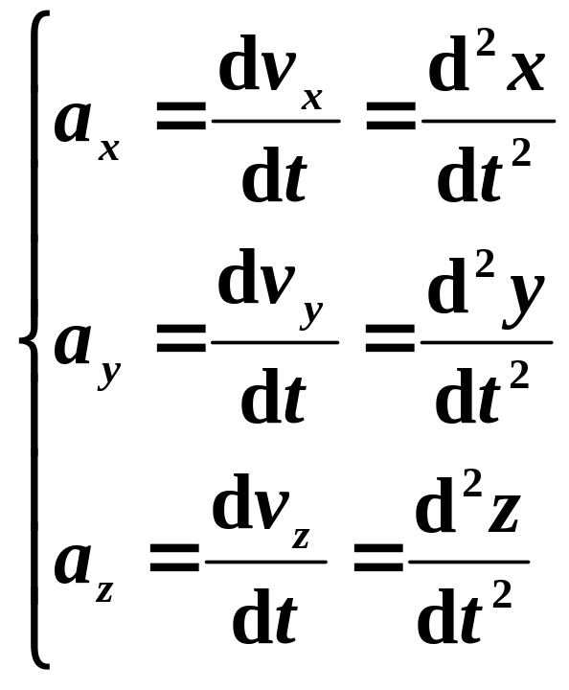
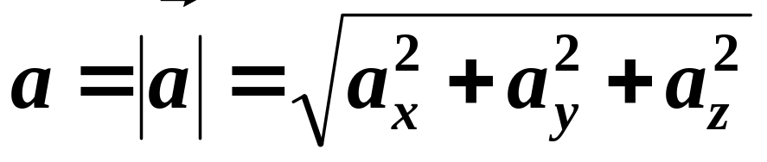
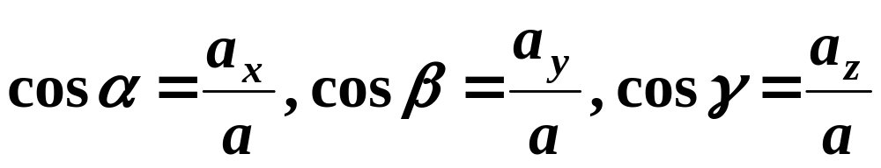

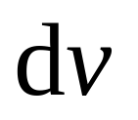
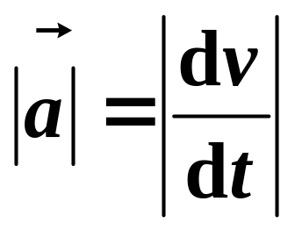
The component form in Cartesian coordinate is:
Direction of :
The limit direction of
Magnitude of :

Slide 14
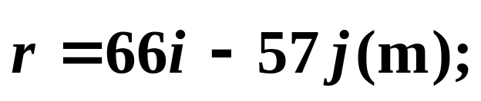
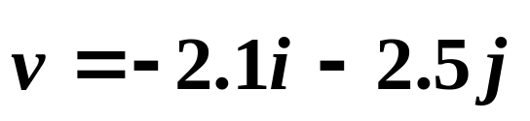
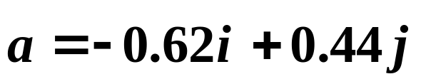
Example:
A cat runs across a parking lot. The coordinates of the cat’s position as functions of time t are given by
x = – 0.31 t² + 7.2 t + 28 , y = 0.22 t² – 9.1 t + 30 (SI)
(a) At t = 15s, what is the cat’s position vector r in unit-vector notation and as a magnitude and an angle?
(b) How about its velocity ; and (c) acceleration ?
(a) r = 87 (m) ; θ = –41º
(b) (m/s); v =3.3 (m/s); θ = –130º
(c) (m/s²); a =0.76 (m/s²); θ = –35º
Solution:

Slide 15
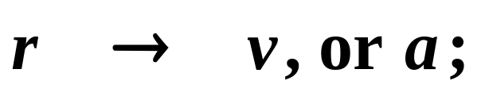
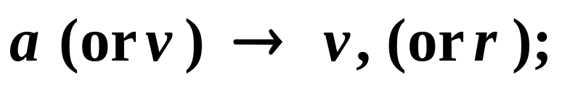
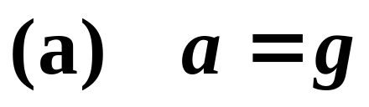




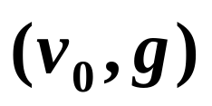
Two kinds of questions belong to the Kinematics:
From
From
2-5. Projectile motion (P54)
Feature:
y
(b) The horizontal and the vertical motion are independent of each other.
运动的独立性;
o
x
The plane of motion is in the one made up by

Slide 16
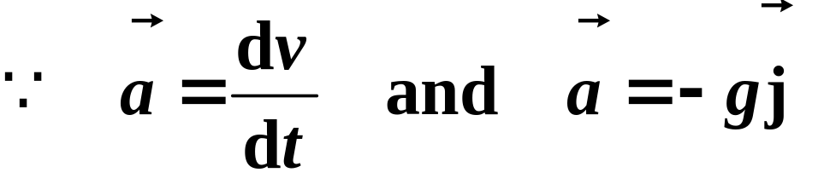
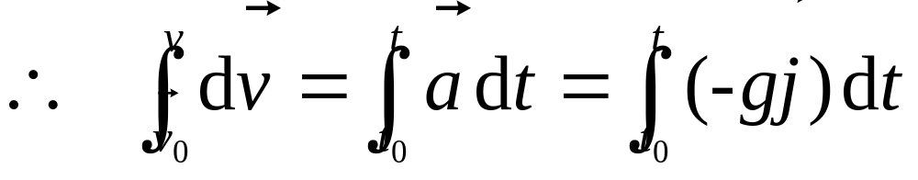
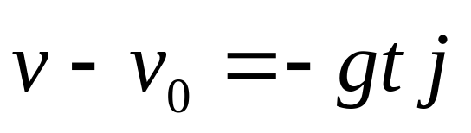
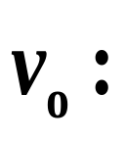
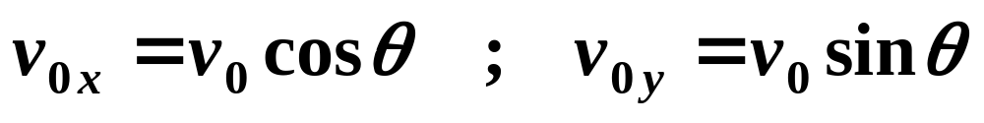
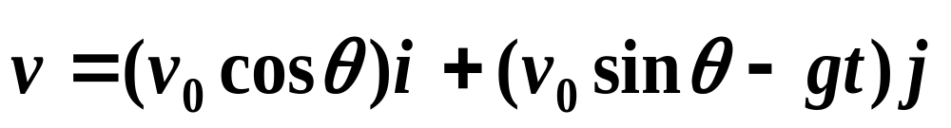
y
H
o
x
R
initial velocity

Slide 17
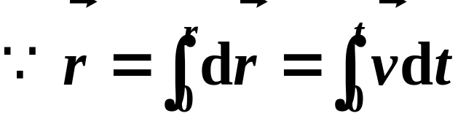
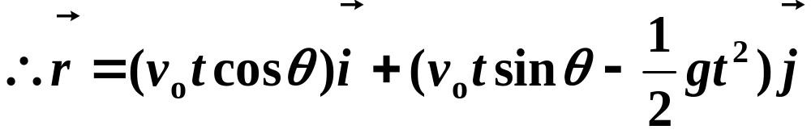





y
H
o
x
R
y
v₀
运动的叠加性
θ
x
0
— superposition of motion
初速度方向的匀速直线运动 + 竖直方向的自由落体运动

Slide 18






Trajectory:
The Horizontal Range an be obtained by setting
This shows that when , one gets
maximum horizontal range for a given v₀.
The maximum fly height H:

Slide 19





Example:
A particle moves along the direction of x axis, a=2t. At t =0, x0=0，v0=0. What are its velocity and position at t =2s?
Solution:
Acceleration, a=2t, is not constant.
So

Slide 20









Example:
A particle moves along x direction, . At t =0, x0=0，v0=0. What is its v(x)?
Solution:
“－” no physical meaning

Slide 21




2-6. Circular Motion
1. Uniform circular motion (P62)
A particle travels around a circular path at a constant speed v, there is still an acceleration and it is always directed radially inward, centripetal
—— a constant
(Radial Unit Vector)
The time for the particle to complete a circle is:
–—– period

Slide 22
















2. Nonuniform Circular Motion (P119)
Both magnitude and direction of velocity change.
B
Changes in magnitude
Changes in direction
O
A

Slide 23






Tangential acceleration:
切向加速度的大小在数值上等于瞬时速率对时间的变化率It only indicates the change in magnitude of velocity (只反映速度大小的变化)。
The direction of : Tangential line.

Slide 24






Normal acceleration：
(因速度方向变化而引起的分加速度)
B
O
A
: radial direction
a_{n}, normal acceleration（法向加速度）is also called a_{R}, radial acceleration（径向加速度）, in our book.

Slide 25










Explanations:
(i) The acceleration in natural coordinate:
where
or
(ii) For general plane-curve motion (平面曲线运动):
ρ : radius of curvature of examine position。
o

Slide 26








Example:
A stone is shot with speed of 30m/s and in horizontal direction. At t= 5.0s, what are its acceleration in tangent and normal direction?
O
x
Given:
Question:
y
Solution:

Slide 27







(1) If the motion function of a particle is x=x(t), y =y(t), then which one is correct in the following expressions, why?
(2) Judge what is correct answer for a particle moves in a curve path in the following expressions:
(a)
(b)
Conceptual example
(c)
(d)

Slide 28







2-7. Relative Motion (P64)
As the figure in P65 shown, we may write:
For memory,
-----Galileo’s velocity transformation
Relative motion, in nature, is the transformation of reference frame.

Slide 29






Example:
N
N
An airplane A flies north
with velocity 300 km/h
relative to the ground;
Another airplane B have
a velocity of 200 km/h
toward a direction 60°
west of north. Find the
velocity of A relative to B.
A
B
Solution:

Slide 30




From triangular relation we can write
and
( The magnitude of is 264.6km/h, and it is in a direction 40.9°east of north )
Question:
?
What is the velocity of B relative to A
Look at the examples given in P65 to 67!

Slide 31









Example:
A woman can row a boat at 4km/h in steel water, (a) If she is crossing a river where the current is 2km/h, in what direction must her boat be headed if she wants to reach a point directly opposite her stating point? (b) If the river is 4km wide, how long will it take her to cross the river?
Solution:
(a)
(b)

Slide 32
The problems of chapter 2:
66, 67, 68
The problems of chapter 3:
11, 18, 23, 25, 58, 60, 62, 65, 66

